Slide 1

Kevin Boyd & Scott Frazier

Slide 2
Breweries Per State

Slide 3
Missing Values

Slide 4
Median ABV and IBU by State

Slide 5
Highest ABV and IBU

Slide 6
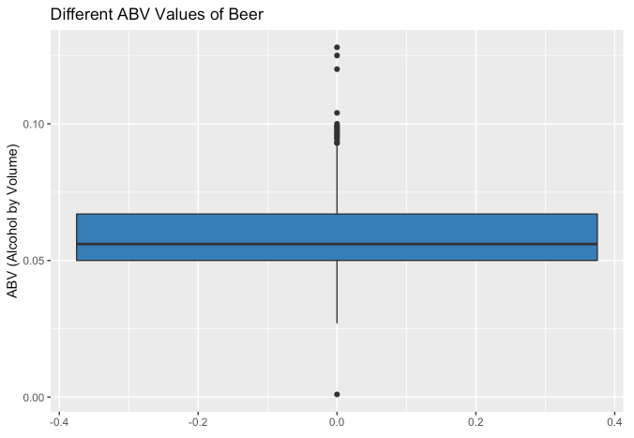
ABV Distribution
Mean: 0.05977
Median: 0.056

Slide 7
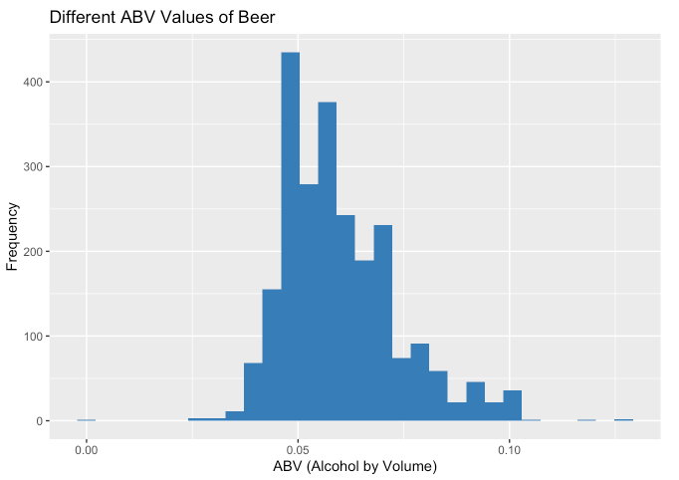
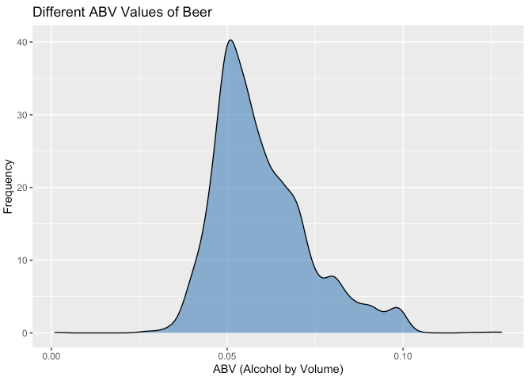
ABV Distribution

Slide 8
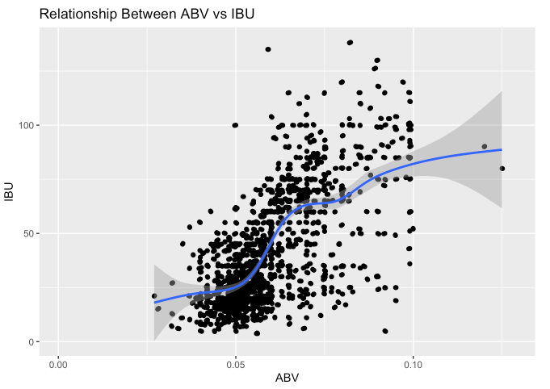
Relationship Between ABV and IBU

Slide 9
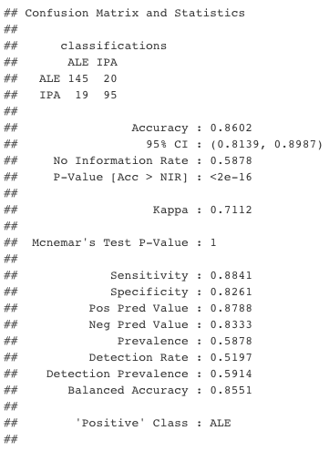
KNN Model

Slide 10
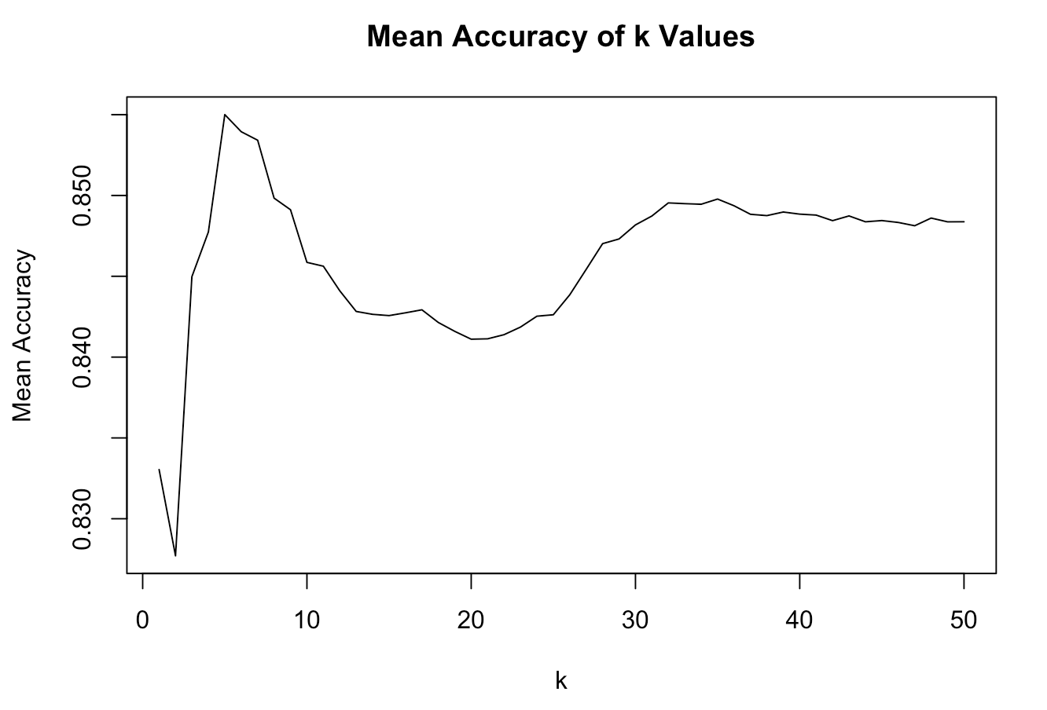
Best Value for K

Slide 11
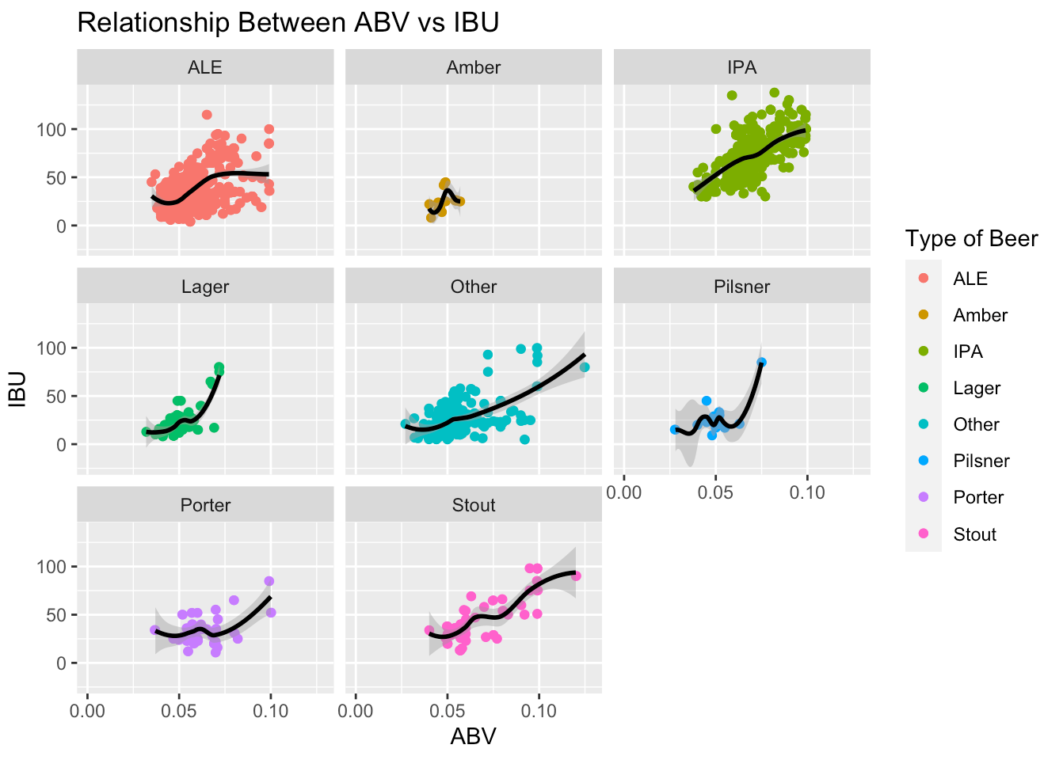
Relationship of ABV and IBU

Slide 12
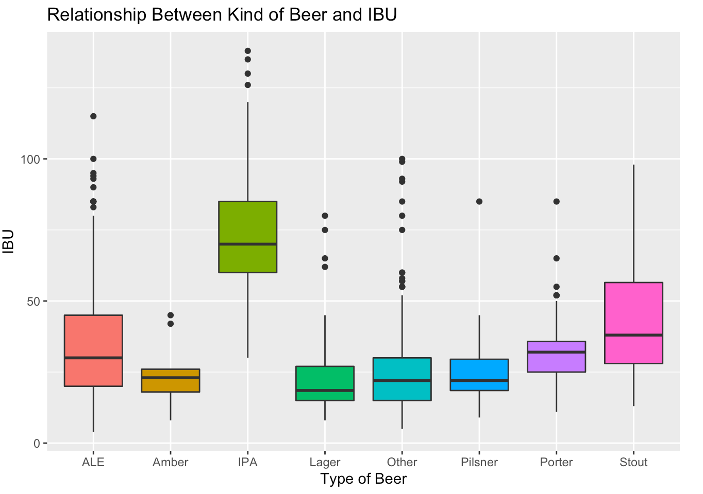
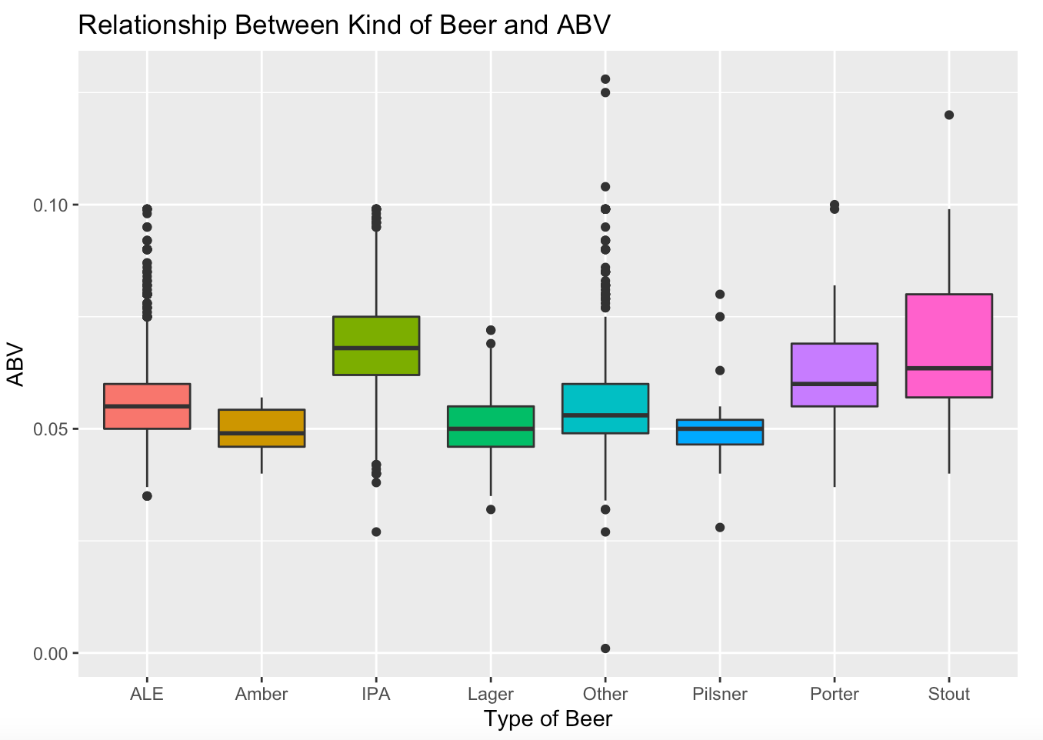
ABV and IBU Distributions

Slide 13
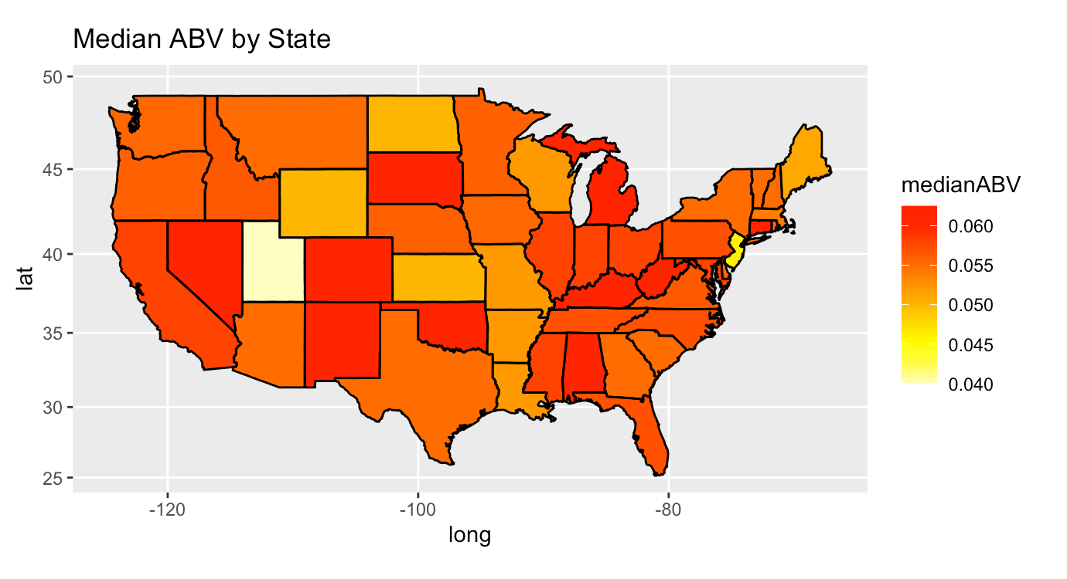
Median ABV

Slide 14
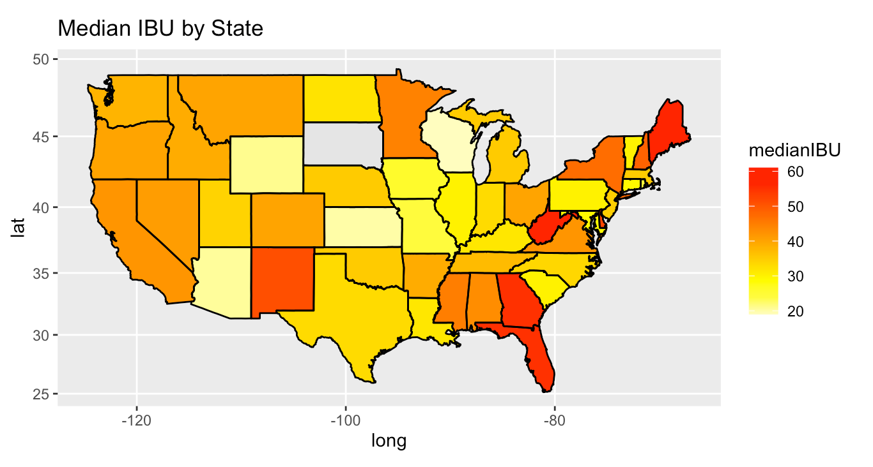
Median IBU

Slide 15
Conclusion

